Slide 1
Icebreaker
To the people around you, please:
Introduce yourselves and your background
Explain what you want to get out of the training
Tell the group about the strangest dataset you have ever come across

Slide 2


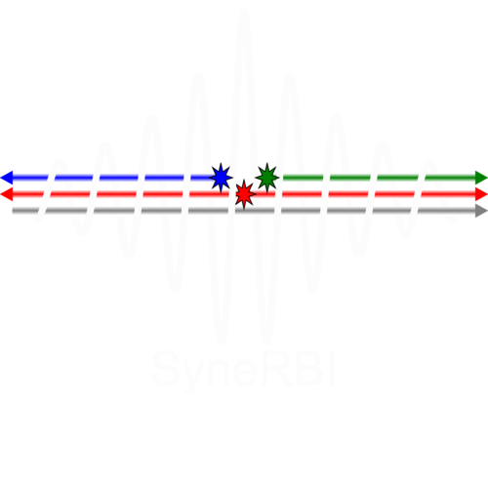





Advanced training for the
Core Imaging Library (CIL)
an open-source reconstruction platform for challenging and novel data.
Gemma Fardell – STFC
Jakob Sauer Jørgensen – DTU
Laura Murgatroyd – STFC
Danica Sugic – STFC
Hannah Robarts - STFC
Evangelos Papoutsellis – Finden
Edoardo Pasca – STFC
Margaret Duff – STFC
Franck Vidal – STFC
Casper da Casta-Luis - STFC

Slide 3
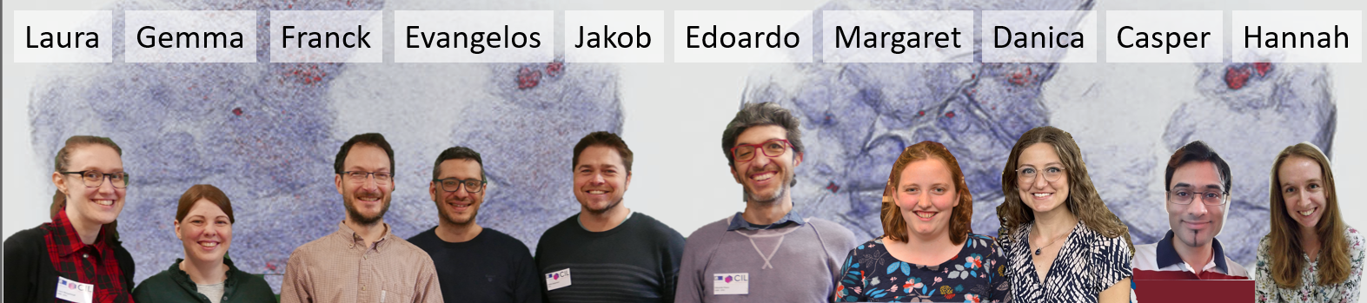
CIL Team

Slide 4
Our goals with this course
Introduction to iterative methods for XCT with CIL
Support you in trying out CIL with our Jupyter notebook demos on the cloud
Set you up to continue exploring CIL for your own data

Slide 5
Training Program
Intro to variational regularisation and optimisation – 1:00-2:30 – Margaret
Intro lecture
Cloud set-up
Demo: 2_Iterative/Optimisation_gd_fista.ipynb
Optional notebook: 4_Deep_Dives/01_callbacks.ipynb
Optional notebook: 4_Deep_Dives/04_preconditioner_stepsize.ipynb
Break
Block Framework - 2:45-3:45 – Jakob
Demo: 2_Iterative/02_tikhonov_block_framework.ipynb
Block framework example lecture
Notebook: 4_Deep_Dives/03_htc_2022.ipynb
Break
Time to explore and discuss – 4:00-4:50 – Jakob
  Notebook: 3_Multichannel/03_Hyperspectral_reconstruction.ipynb
  Notebook: 2_Iterative/05_Laminography_with_TV.ipynb
  Notebook: 1_Introduction/exercises/03_where_is_my_reader.ipynb
  Notebook: 4_Deep_Dives/04_phase_retrieval.ipynb
Conclusions 4:50-5

Slide 6

Disclaimer
New training format
New cloud platform
New notebooks
Any feedback, bugs and typos found are all very welcome (please be nice)!

Slide 7
Training Program
Intro to variational regularisation and optimisation – 1:00-2:30 – Margaret
Intro lecture
Cloud set-up
Demo: 2_Iterative/Optimisation_gd_fista.ipynb
Optional notebook: 4_Deep_Dives/01_callbacks.ipynb
Optional notebook: 4_Deep_Dives/04_preconditioner_stepsize.ipynb
Break
Block Framework - 2:45-3:45 – Jakob
Demo: 2_Iterative/02_tikhonov_block_framework.ipynb
Block framework example lecture
Notebook: 4_Deep_Dives/03_htc_2022.ipynb
Break
Time to explore and discuss – 4:00-4:50 – Jakob
  Notebook: 3_Multichannel/03_Hyperspectral_reconstruction.ipynb
  Notebook: 2_Iterative/05_Laminography_with_TV.ipynb
  Notebook: 1_Introduction/excercises/03_where_is_my_reader.ipynb
  Notebook: 4_Deep_Dives/04_phase_retrieval.ipynb
Conclusions 4:50-5
Notes:
Same breakout rooms (groups of 5ish) for all 3 sessions.
Jakob and Franck – hosts on Monday

Slide 8
CIL reminder

Slide 9
What is the Core Imaging Library?
A Python library for processing and reconstruction of tomography data.
Optimised standard methods, such as Filtered Back Projection
Special emphasis on challenging data sets: noisy, non-standard, incomplete, multi-channel, ...
Highly modular to allow creation of bespoke pipelines.
Apache v2 license.
Actively developed on GitHub: https://github.com/TomographicImaging/CIL

Slide 10
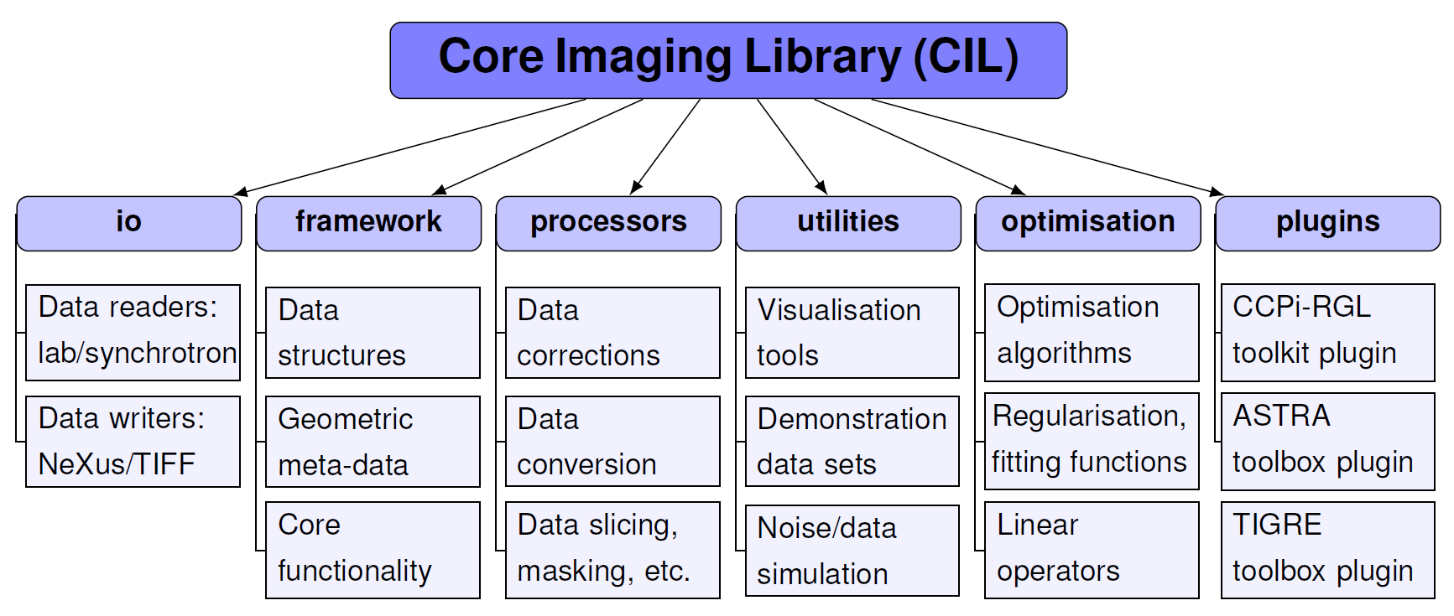
CIL Module Structure and Contents
recon
FBP/FDK
Jørgensen et al. 2021: Core Imaging Library - Part I: a versatile Python framework for tomographic imaging, Phil. Trans. R. Soc. A, 379, 20200192: https://doi.org/10.1098/rsta.2020.0192

Slide 11
Iterative Reconstruction

Slide 12
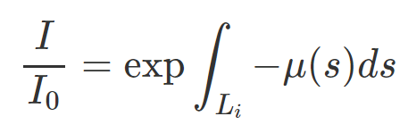
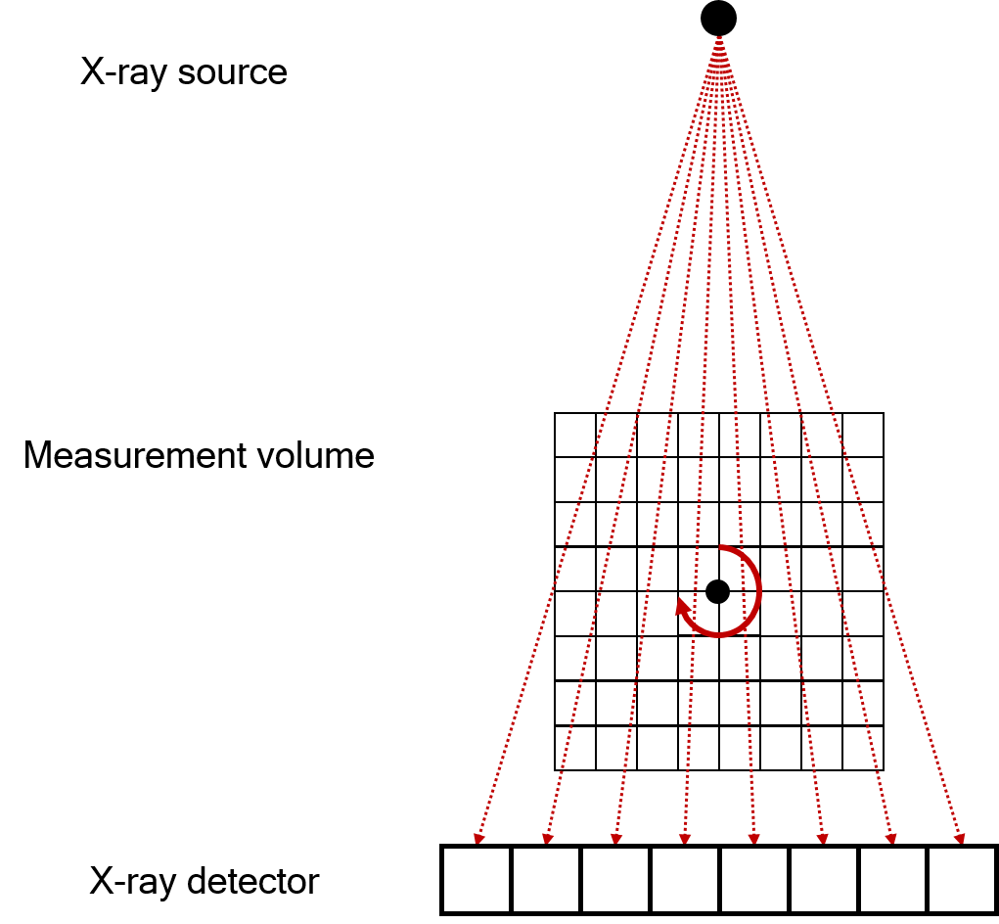

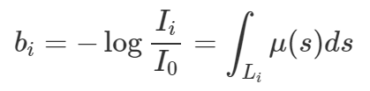


Imaging Model for Iterative Reconstruction
Assume the object is constant in each pixel
u_{j} is the j-th pixel value
a_{ij} is the path length in the j-th pixel

Slide 13

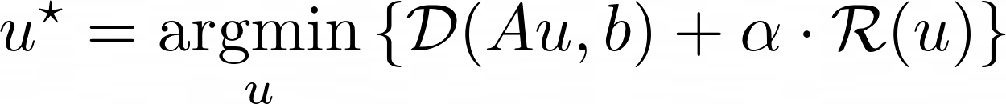
Imaging Model for Iterative Reconstruction
Extremely large set of linear equations
Iterative reconstruction is based on optimisation algorithms and objective functions
Plan to minimise
Thing you want to minimise

Slide 14




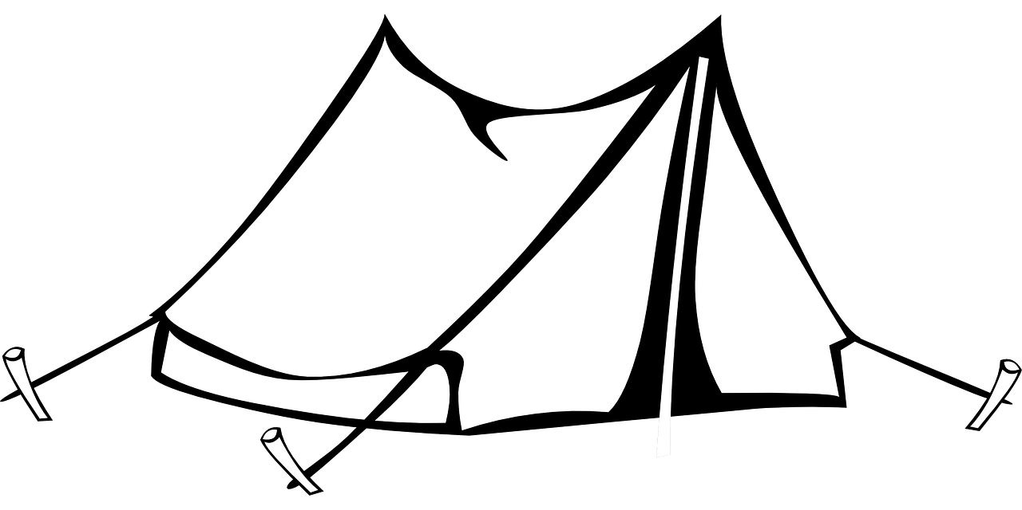
Optimisation algorithms
$$L[andscape]\left(u\right)=D[anger]\left(Au,b\right)$$
Notes:
Mention convexity

Slide 15

Optimisation algorithms – Gradient Descent
$$L[andscape]\left(u\right)=D[anger]\left(Au,b\right)$$
$$u_{k+1}=u_{k}−β∇L(u_{k})$$

Slide 16

Optimisation algorithms – Gradient Descent
Objective = loss landscape
$$L[andscape]\left(u\right)=D[anger]\left(Au,b\right)$$
$$u_{k+1}=u_{k}−β∇L(u_{k})$$
Optimisation algorithm = plan to get to the bottom

Slide 17
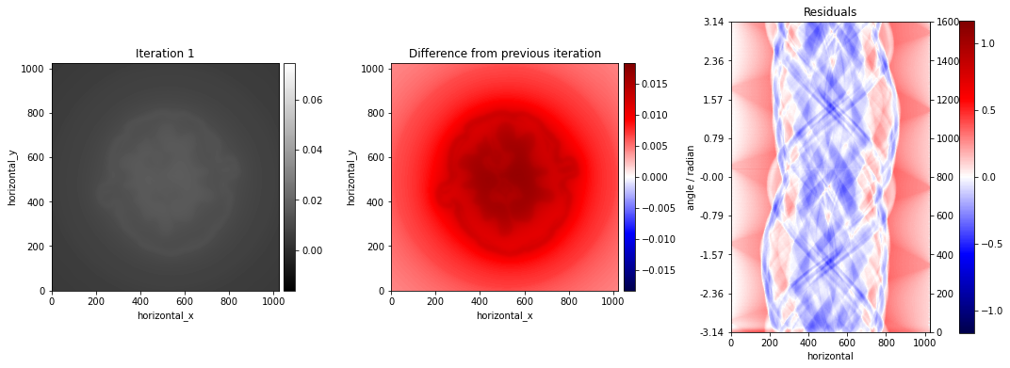
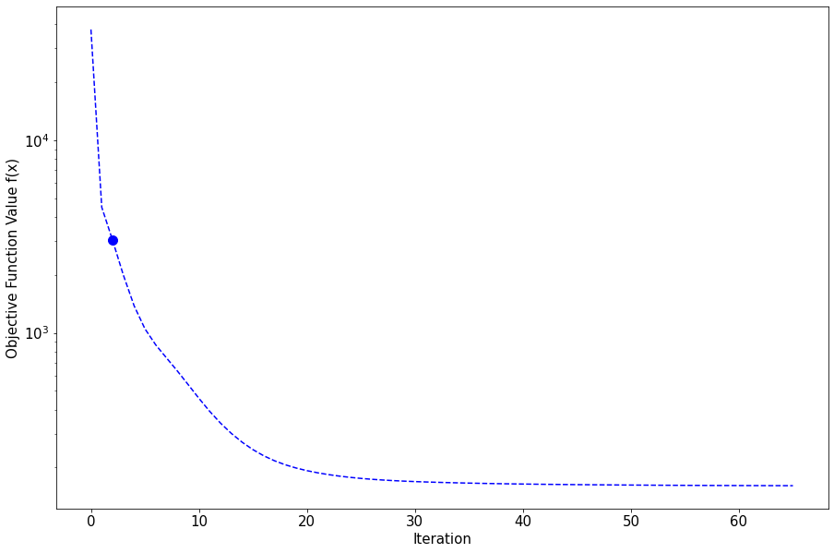

Solve optimisation problem iteratively
28

Slide 18
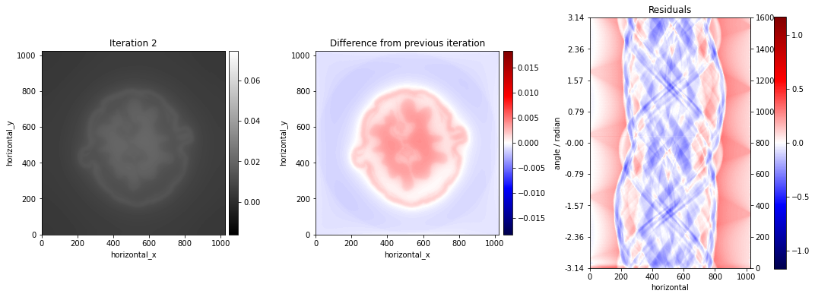
Solve optimisation problem iteratively

Slide 19
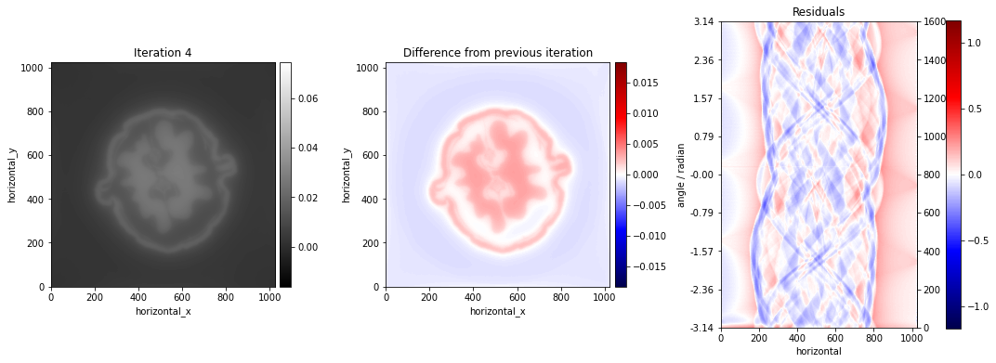
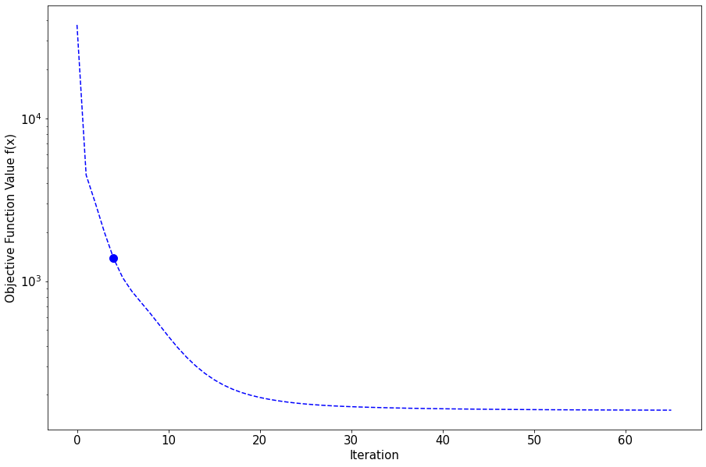
Solve optimisation problem iteratively

Slide 20
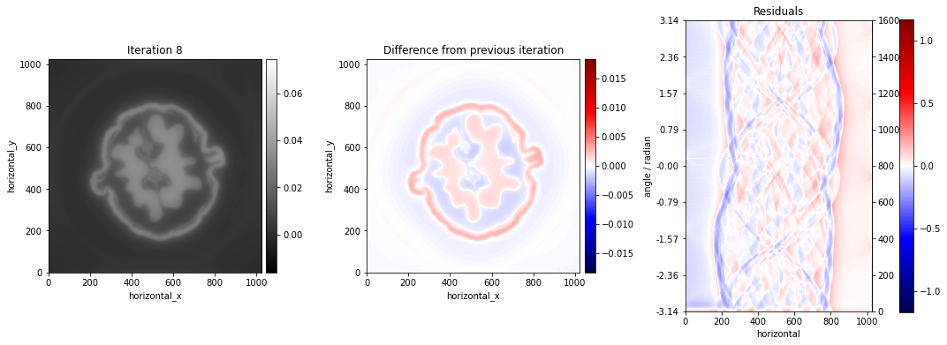
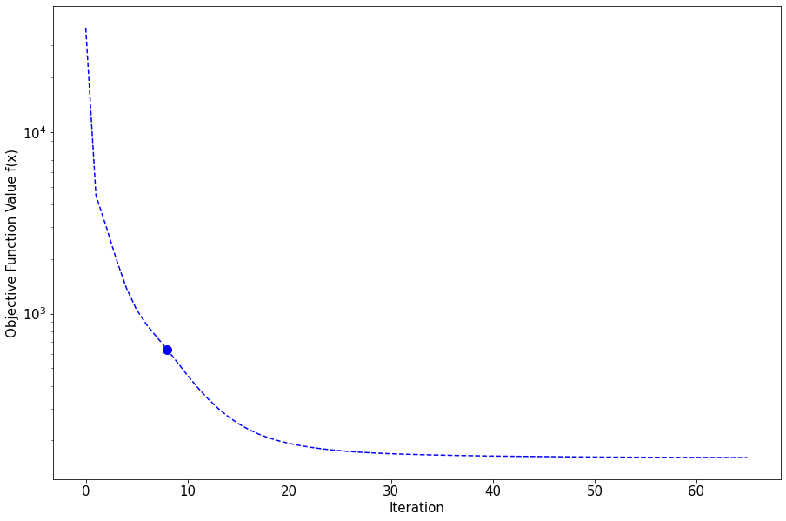
Solve optimisation problem iteratively

Slide 21

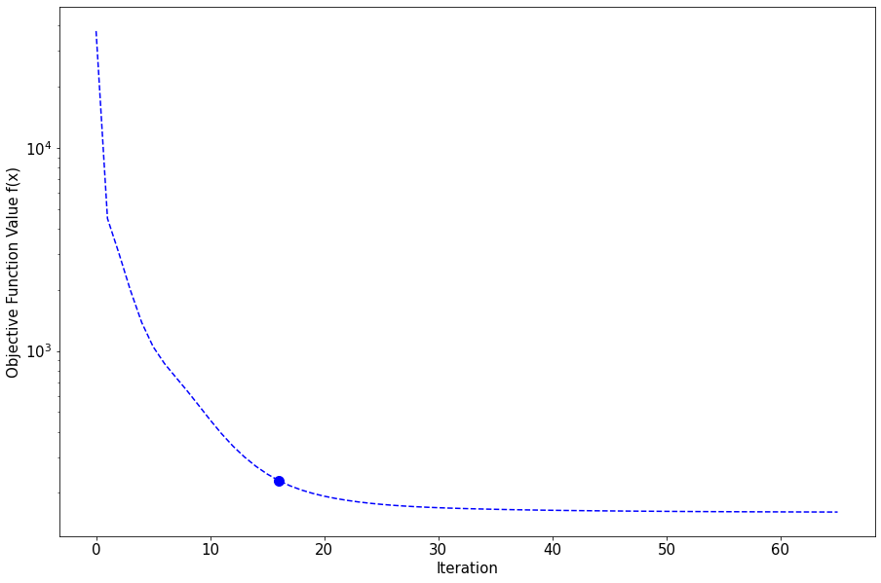
Solve optimisation problem iteratively

Slide 22
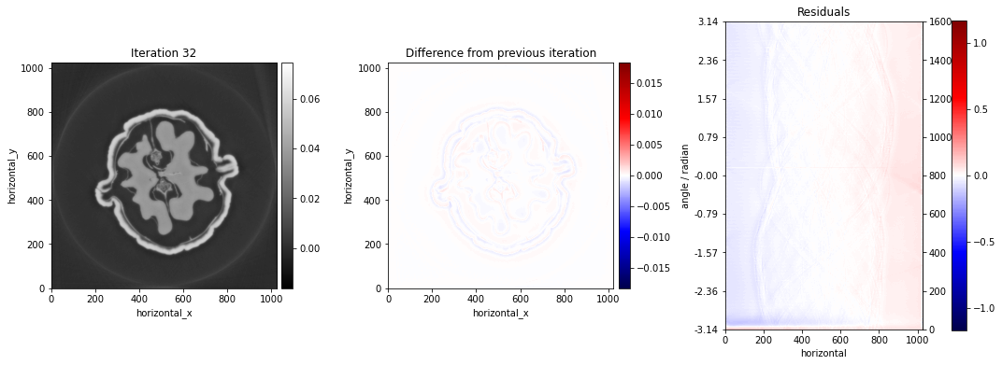
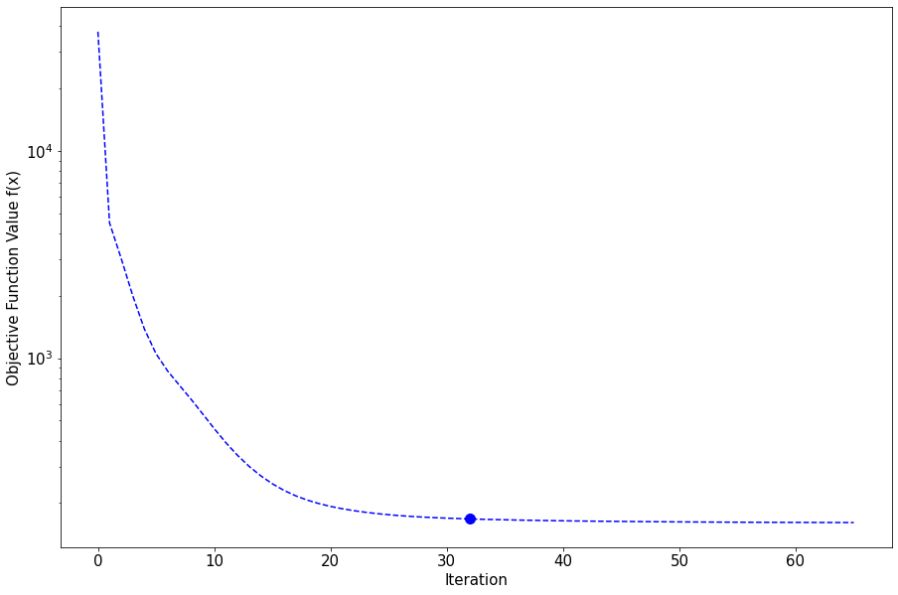
Solve optimisation problem iteratively

Slide 23

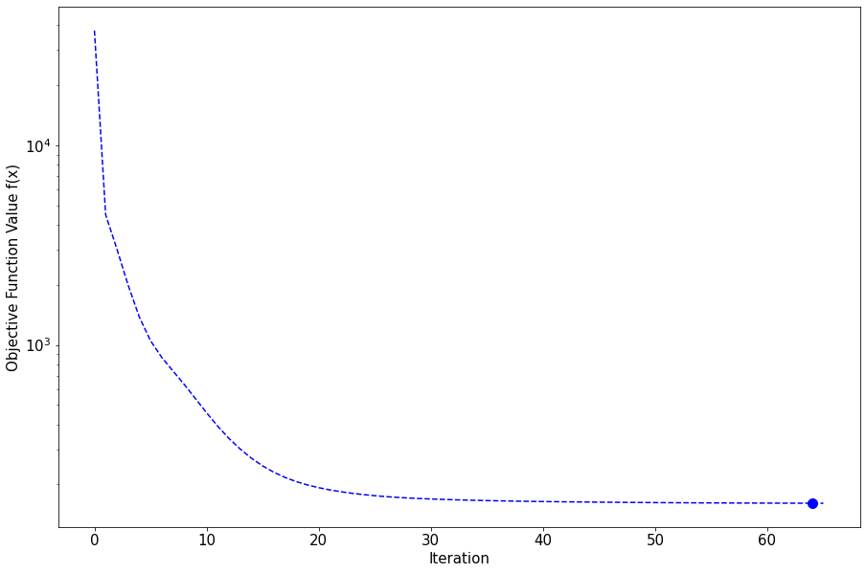
Solve optimisation problem iteratively

Slide 24
Regularisation

Slide 25


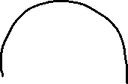

Demonstration dataset
Jørgensen et al.: Core Imaging Library - Part I: a versatile Python framework for tomographic imaging Phil. Trans. R. Soc. A. 379 20200192 (2021) DOI: 10.1098/rsta.2020.0192
3D parallel-beam X-ray CT dataset from Beamline I13-2, Diamond Light Source.
0.5 mm aluminium cylinder with a piece of steel wire embedded in a small drilled hole. A droplet of salt water was placed on top, causing corrosion to form hydrogen bubbles.
160x135 15 projections over 180°
Salt water
Steel wire
Aluminium cylinder

Slide 26
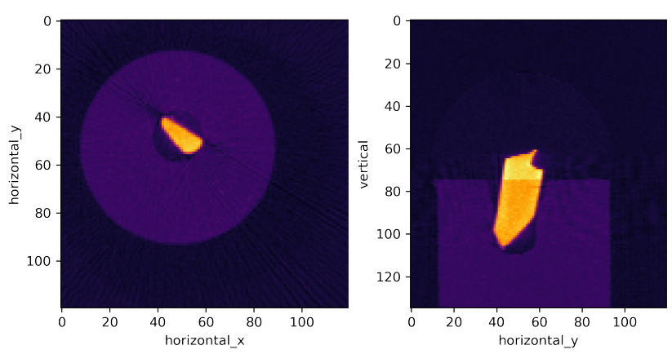
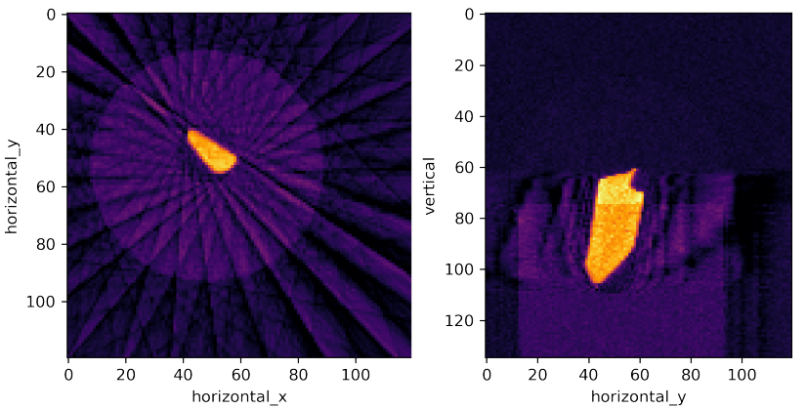
Demonstration dataset
Filtered backprojection
Horizontal slice
Vertical slice
90 projections
15 projections
26

Slide 27
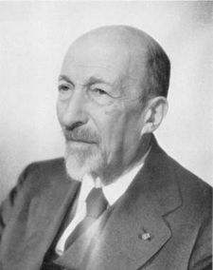
Iterative Reconstruction with Regularisation
Extremely large set of linear equations
Ill posed problem
Iterative reconstruction is based on optimisation algorithms and objective functions

Slide 28
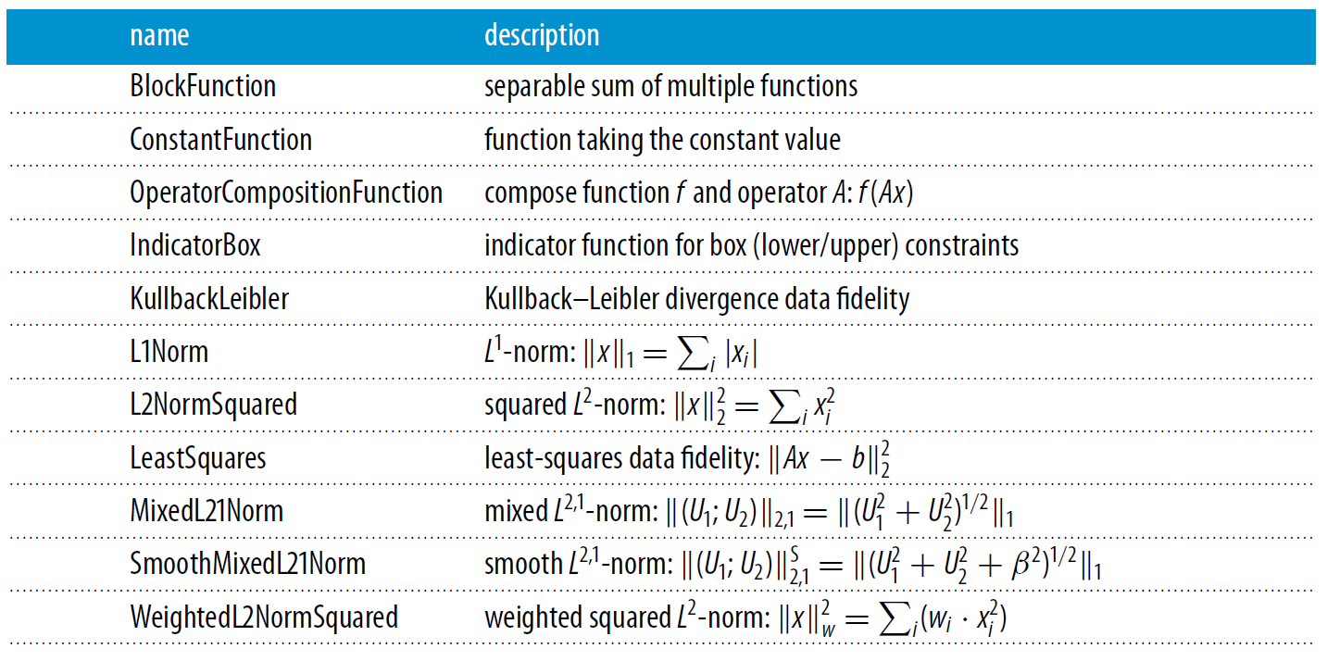
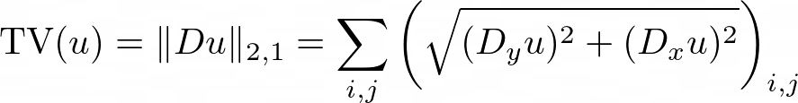
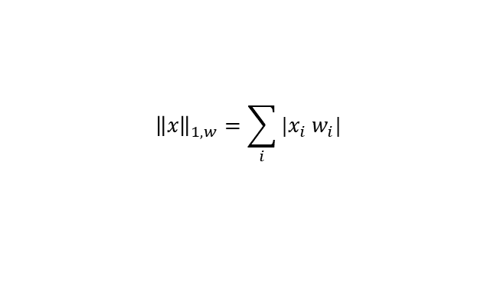
Functions in CIL
TotalVariation
WeightedL1Norm
$${\left\|x\right\|}_{1,w}=\sum_{i}{|x_{i}{ w}_{i}|}$$
ApproximateGradientSumFunction
…
SGFunction
…

Slide 29

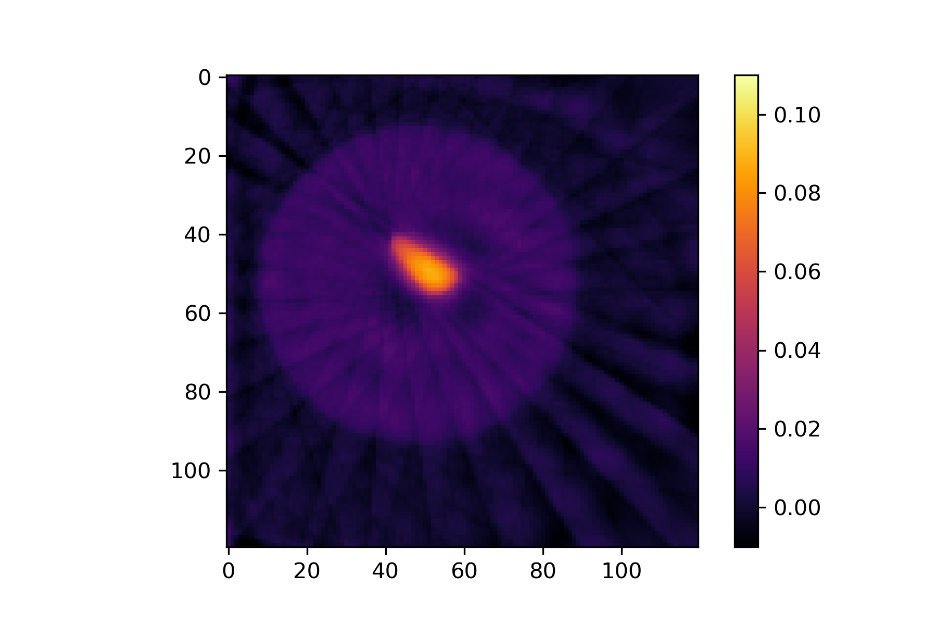
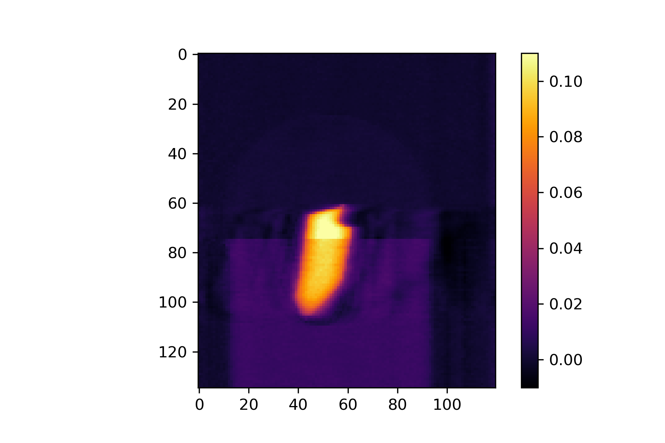
Smooth Regularisation: Tikhonov
Data fidelity
Regulariser
Minimiser: Solution image
Unknown image TBD
Regularisation parameter
29

Slide 30
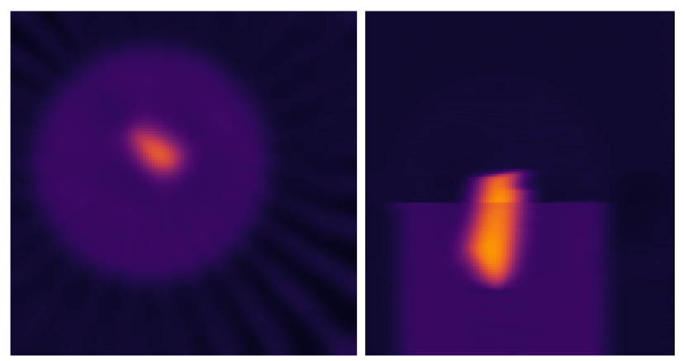
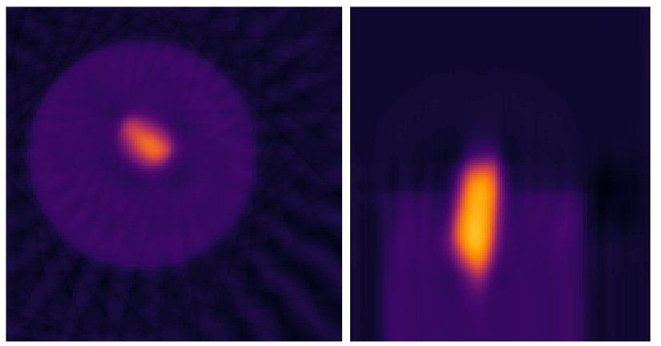
Smooth Regularisation: Anisotropic Tikhonov
Large horizontal,
small vertical smoothing
Small horizontal,
large vertical smoothing
30

Slide 31
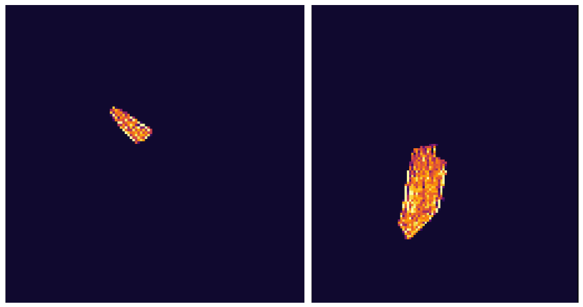

Sparsity: L1 Regularization
L1-norm regularisation:

Slide 32
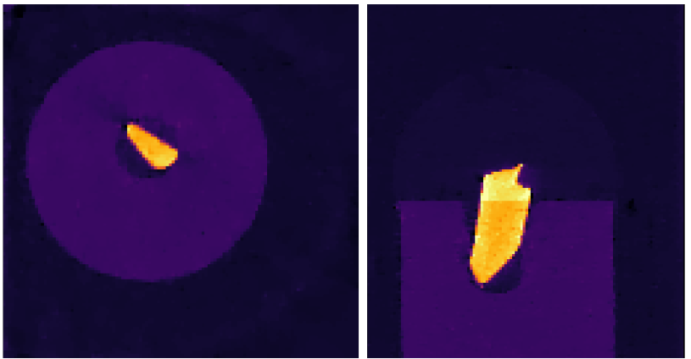
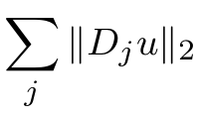
Sparsity and Total Variation Regularization
L1-norm regularisation:
Total variation regularisation:
32

Slide 33
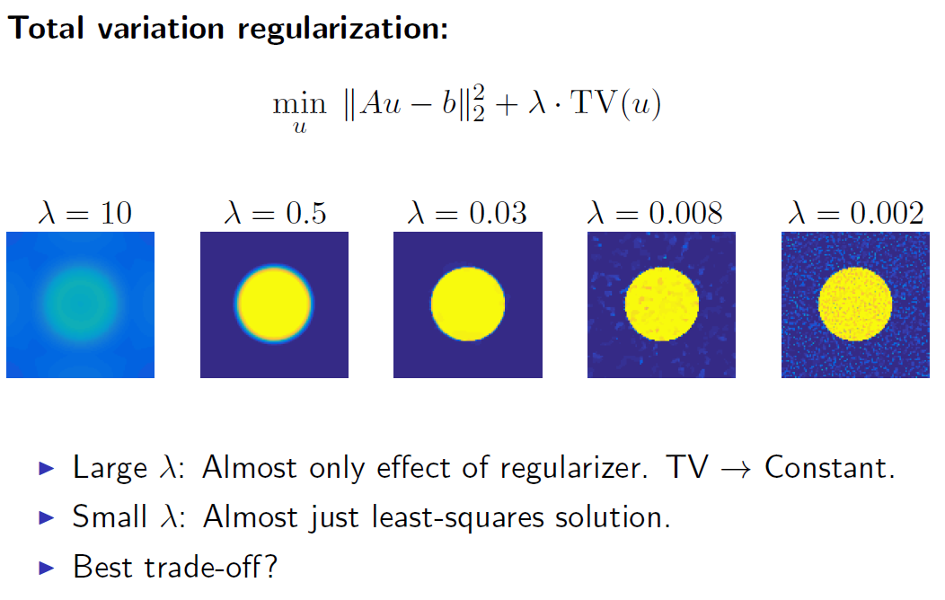
Effect of the Regularisation Parameter

Slide 34
Questions?

Slide 35
More on Iterative Reconstruction

Slide 36
Optimisation algorithms – Gradient Descent
Objective = loss landscape
$$L[andscape]\left(u\right)=D[anger]\left(Au,b\right)$$
$$u_{k+1}=u_{k}−β∇L(u_{k})$$
Optimisation algorithm = plan to get to the bottom

Slide 37

Optimisation algorithms – Non smooth
Need a different optimisation algorithm = need a new plan

Slide 38
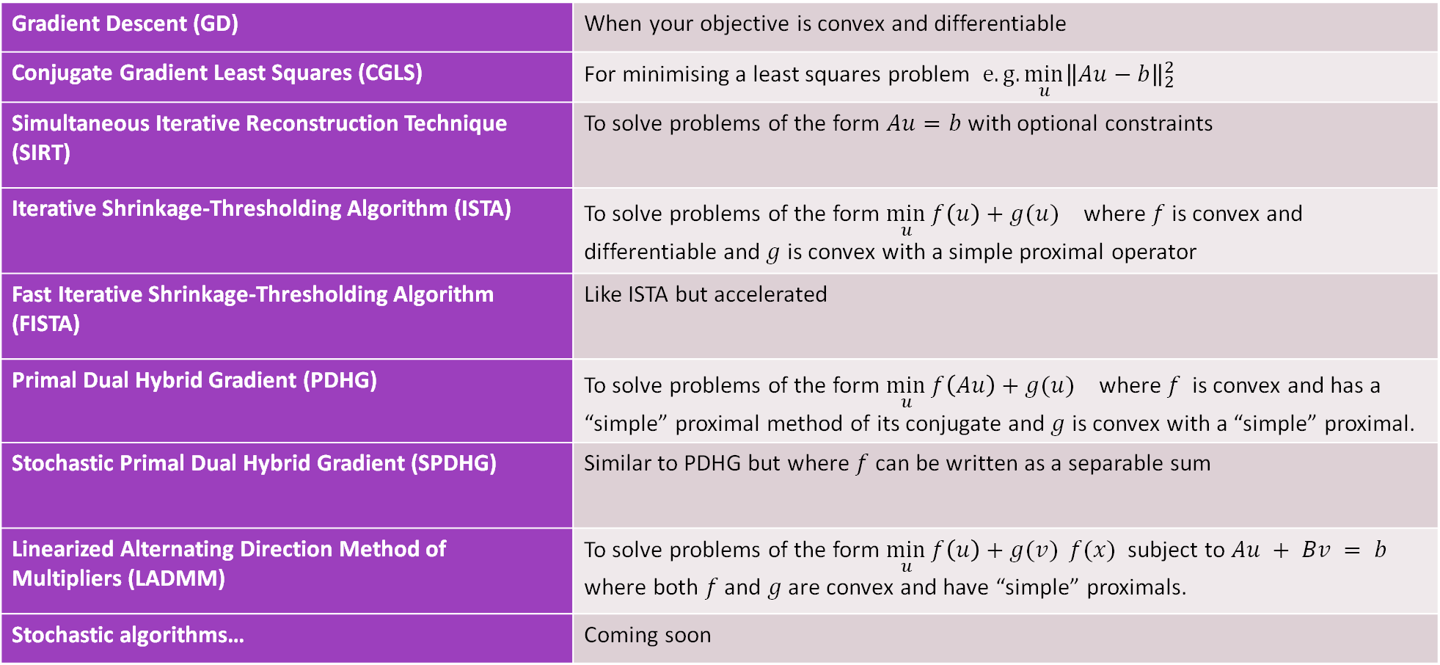
Optimisation algorithms in CIL
Gradient Descent (GD) | When your objective is convex and differentiable
Conjugate Gradient Least Squares (CGLS) | For minimising a least squares problem $e.g.\min_{u}{\left\|Au−b\right\|}_{2}^{2}$
Simultaneous Iterative Reconstruction Technique (SIRT) | To solve problems of the form $Au=b$ with optional constraints
Iterative Shrinkage-Thresholding Algorithm (ISTA) | To solve problems of the form ${\min_{u}{f\left(u\right)+g(u)}}_{}^{}$ where $f$ is convex and differentiable and $g$ is convex with a simple proximal operator
Fast Iterative Shrinkage-Thresholding Algorithm (FISTA) | Like ISTA but accelerated
Primal Dual Hybrid Gradient (PDHG) | To solve problems of the form ${\min_{u}{f\left(Au\right)+g(u)}}_{}^{}$ where $f$ is convex and has a “simple” proximal method of its conjugate and $g$ is convex with a “simple” proximal.
Stochastic Primal Dual Hybrid Gradient (SPDHG) | Similar to PDHG but where $f$ can be written as a separable sum
Linearized Alternating Direction Method of Multipliers (LADMM) | To solve problems of the form $\min_{u}{f\left(u\right)+g(v)} f(x)$ subject to $Au + Bv = b$ where both $f$ and $g$ are convex and have “simple” proximals.
Stochastic algorithms… | Coming soon

Slide 39

Optimisation algorithms in CIL
Gradient Descent (GD) | When your objective is convex and differentiable
Conjugate Gradient Least Squares (CGLS) | For minimising a least squares problem $e.g.\min_{u}{\left\|Au−b\right\|}_{2}^{2}$
Simultaneous Iterative Reconstruction Technique (SIRT) | To solve problems of the form $Au=b$ with optional constraints
Iterative Shrinkage-Thresholding Algorithm (ISTA) | To solve problems of the form ${\min_{u}{f\left(u\right)+g(u)}}_{}^{}$ where $f$ is convex and differentiable and $g$ is convex with a simple proximal operator
Fast Iterative Shrinkage-Thresholding Algorithm (FISTA) | Like ISTA but accelerated
Primal Dual Hybrid Gradient (PDHG) | To solve problems of the form ${\min_{u}{f\left(Au\right)+g(u)}}_{}^{}$ where $f$ is convex and has a “simple” proximal method of its conjugate and $g$ is convex with a “simple” proximal.
Stochastic Primal Dual Hybrid Gradient (SPDHG) | Similar to PDHG but where $f$ can be written as a separable sum
Linearized Alternating Direction Method of Multipliers (LADMM) | To solve problems of the form $\min_{u}{f\left(u\right)+g(v)} f(x)$ subject to $Au + Bv = b$ where both $f$ and $g$ are convex and have “simple” proximals.
Stochastic algorithms… | Coming soon

Slide 40
CIL module structure and contents
recon
FBP/FDK
Jørgensen et al. 2021: Core Imaging Library - Part I: a versatile Python framework for tomographic imaging, Phil. Trans. R. Soc. A, 379, 20200192: https://doi.org/10.1098/rsta.2020.0192

Slide 41
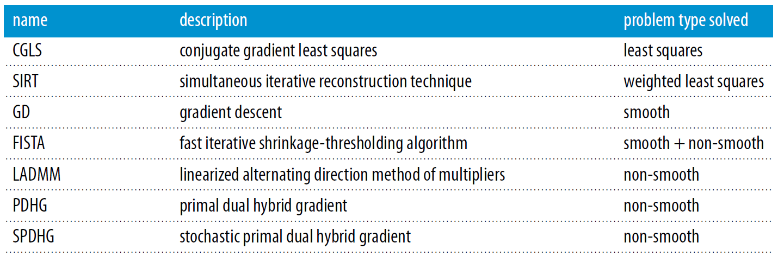
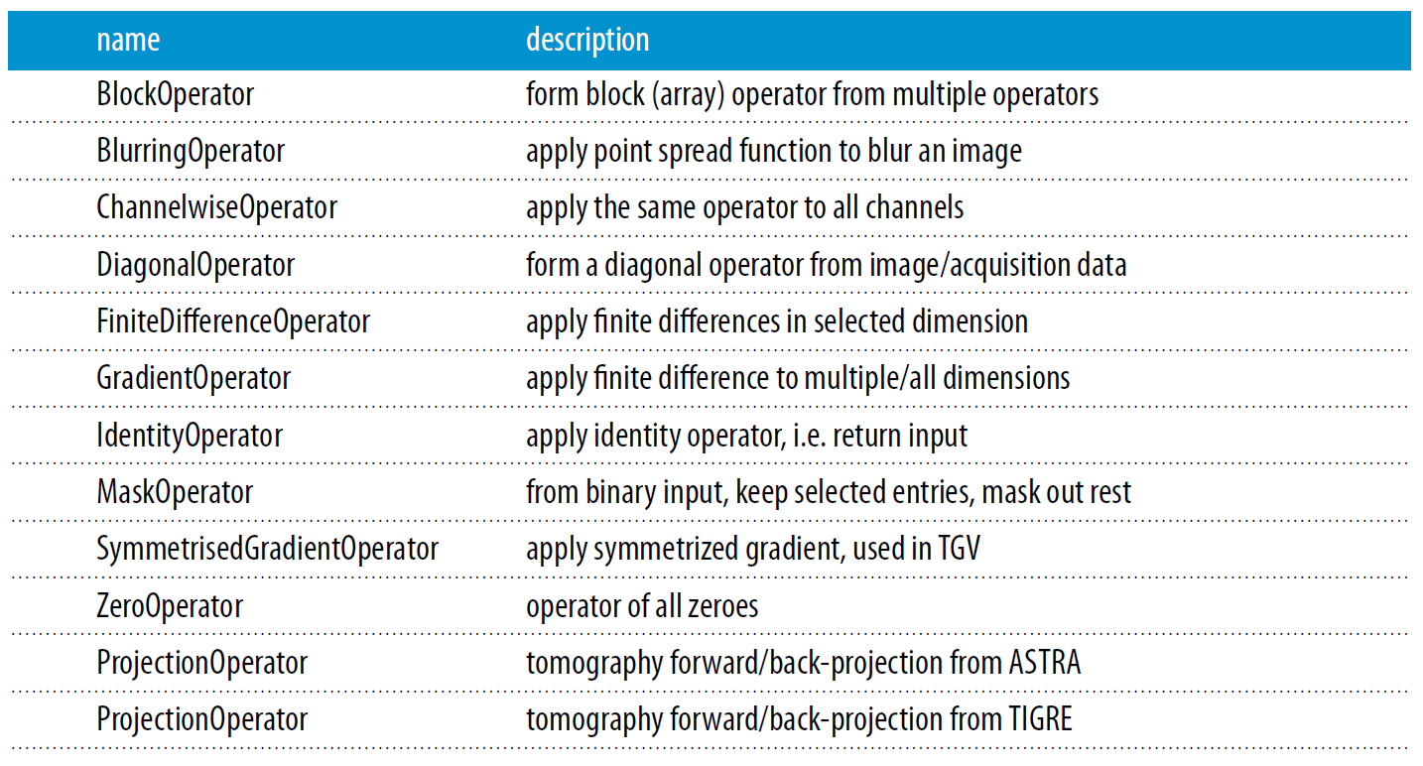
CIL Optimisation module
TotalVariation

Slide 42
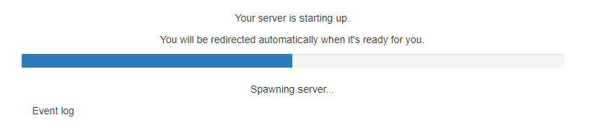
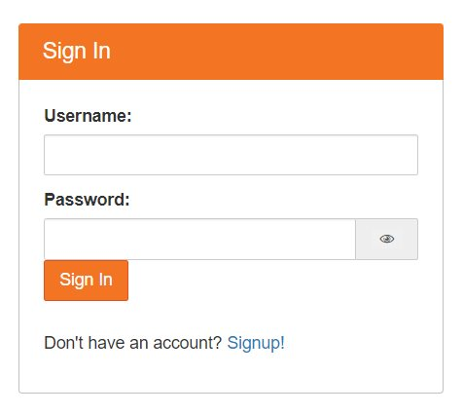
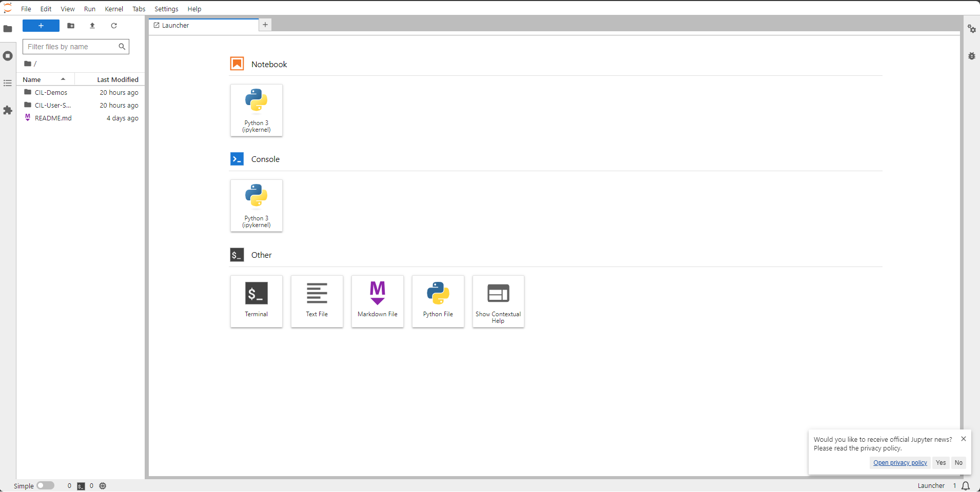
Log in to JupyterHub
Go to the link provided
Enter the username and password on your slip of paper​
Wait for the server to start up​
Check you can see the CIL-Demos folder

Slide 43
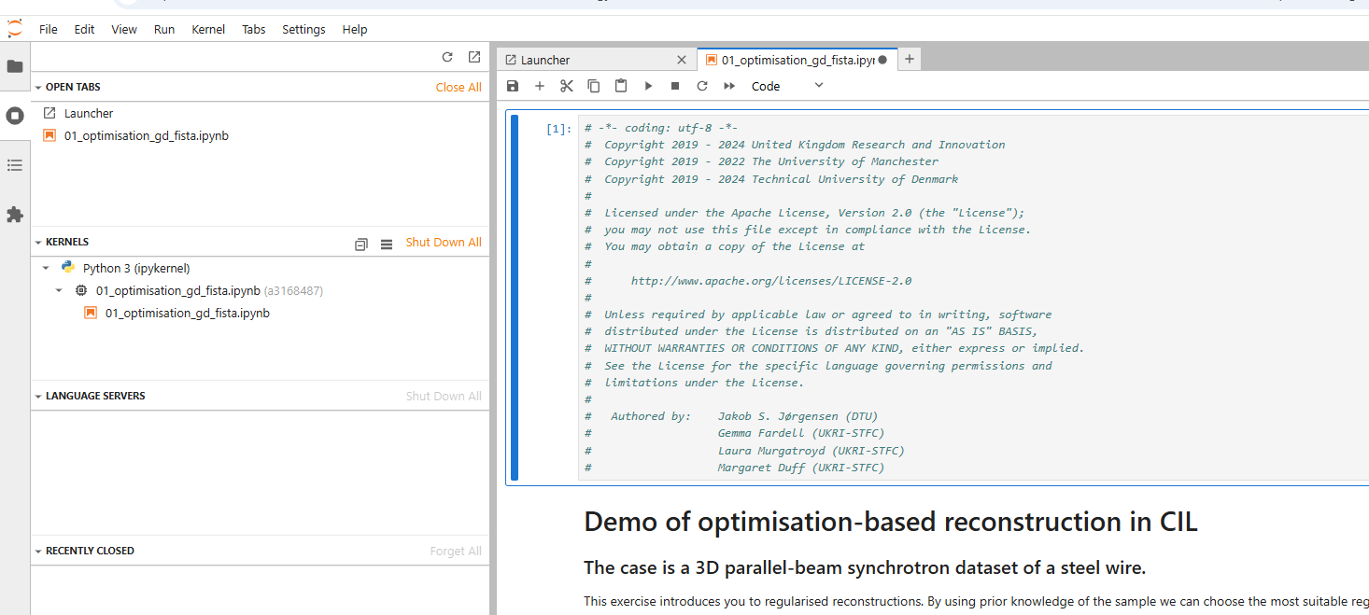
Killing kernels – IMPORTANT

Slide 44
Demonstration
Go to:
CIL-Demos/demos/2_Iterative/01_optimisation_gd_fista.ipynb
Learning Objectives:
Load a dataset and reconstruct with FBP
Set-up a least-squares problem to solve using CIL's algorithms, a projection operator and objective function
Add regularisation to the least-squares problem and compare the results: Tikhonov, Non-negativity, L1-Norm, Total-Variation
Solve the optimisation problem with the appropriate algorithm: Gradient Descent, FISTA, PDHG

Slide 45
Time to explore
Option 1 : CIL-Demos/demos/4_Deep Dives/01_callbacks.ipynb
Explore the default behaviour of callbacks in CIL
Demonstrate customisable callbacks in CIL for reporting and early stopping
Complex callback example for calculating a dictionary of metrics evaluated on a region of interest
Option 2: CIL-Demos/demos/4_Deep_Dives/04_preconditioner_stepsize.ipynb
Explore and compare a range of step size methods in CIL
Learn how to implement your own step size rule in CIL
Learn about the concept of preconditioning for gradient descent based methods
Explore the preconditioners currently available in CIL

Slide 46
Questions?

Slide 47
Break

Slide 48
Block Framework

Slide 49
Training Program
Intro to variational regularisation and optimisation – 1:00-2:30 – Margaret
Intro lecture
Cloud set-up
Demo: 2_Iterative/Optimisation_gd_fista.ipynb
Optional notebook: 4_Deep_Dives/01_callbacks.ipynb
Optional notebook: 4_Deep_Dives/04_preconditioner_stepsize.ipynb
Break
Block Framework - 2:45-3:45 – Jakob
Demo: 2_Iterative/02_tikhonov_block_framework.ipynb
Block framework example lecture
Notebook: 4_Deep_Dives/03_htc_2022.ipynb
Break
Time to explore and discuss – 4:00-4:50 – Jakob
  Notebook: 3_Multichannel/03_Hyperspectral_reconstruction.ipynb
  Notebook: 2_Iterative/05_Laminography_with_TV.ipynb
  Notebook: 1_Introduction/excercises/03_where_is_my_reader.ipynb
  Notebook: 4_Deep_Dives/04_phase_retrieval.ipynb
Conclusions 4:50-5

Slide 50
Demonstration
Go to:
CIL-Demos/demos/2_Iterative/02_tikhonov_block_framework.ipynb
Learning Objectives:
1. Construct and manipulate BlockOperators and BlockDataContainer, including direct and adjoint operations and algebra.
2. Use Block Framework to solve Tikhonov regularisation with CGLS algorithm.
3. Apply Tikhonov regularisation to tomographic reconstruction and explain the effect of regularisation parameter and operator in regulariser.

Slide 51
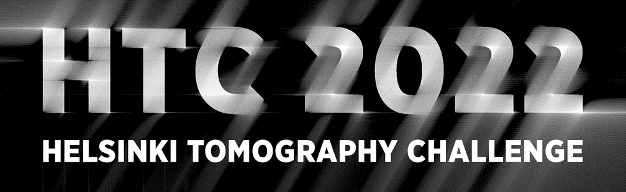
Example of block framework and modularity
Competition (CIL team finished 3rd)
https://www.fips.fi/HTC2022.php
Article describing methods:
A directional regularization method for the limited-angle Helsinki Tomography Challenge using the Core Imaging Library (CIL)
https://www.aimsciences.org/article/doi/10.3934/ammc.2023011

Slide 52
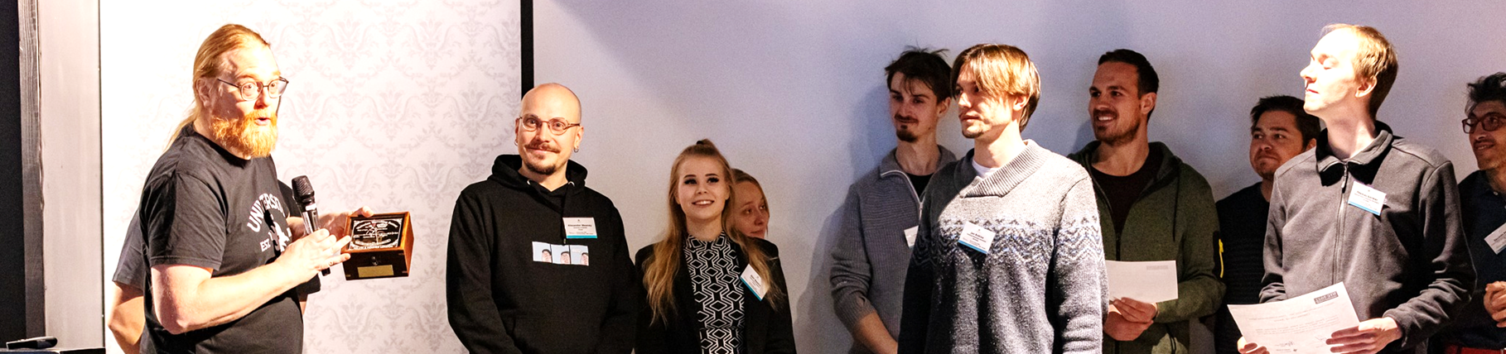
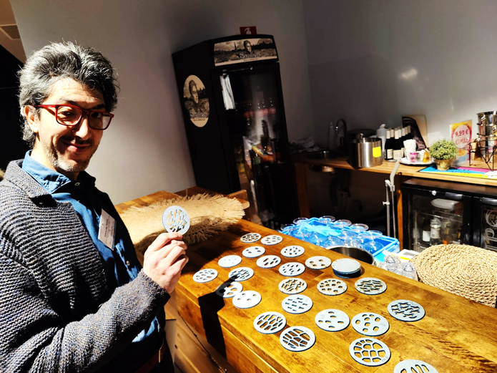
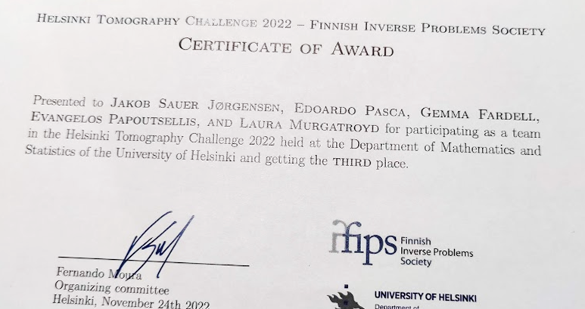
Special award session, Inverse Days 2022

Slide 53
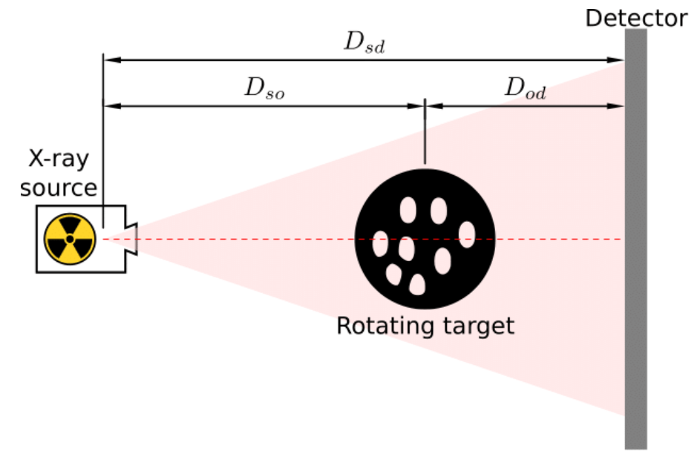


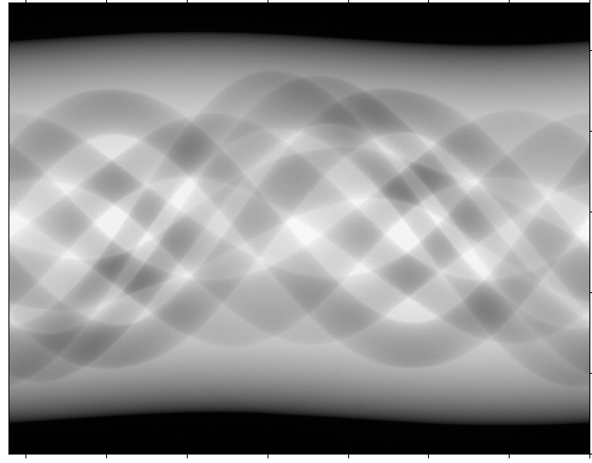


Test data provided and scan setup
Four 360 degree measured sinogram data sets to generate limited-angle data from
Reference reconstructions and segmentations
360 deg sinogram

Slide 54
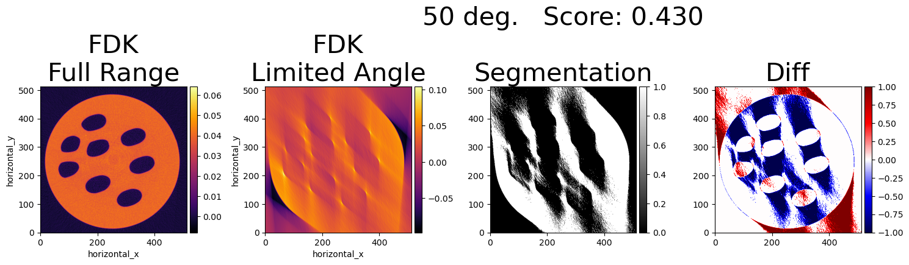
Motivation
See how far "conventional" CT pre-processing plus variational methods could go
Use existing general purpose CIL tools as much as possible – limited time for new dev

Slide 55
Reconstruction: Exploit prior knowledge
Construct optimization problem to express what we know:
Single homogeneous material
Sharp edges
Object is approximately disk shaped
Zero attenuation outside the object
Constant value of 0.0409 mm⁻¹ inside the object
Edges perpendicular to projection angles are the
most difficult (micro-local analysis)
55

Slide 56
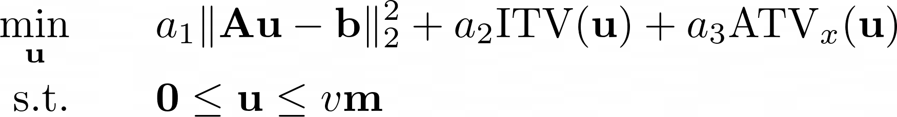

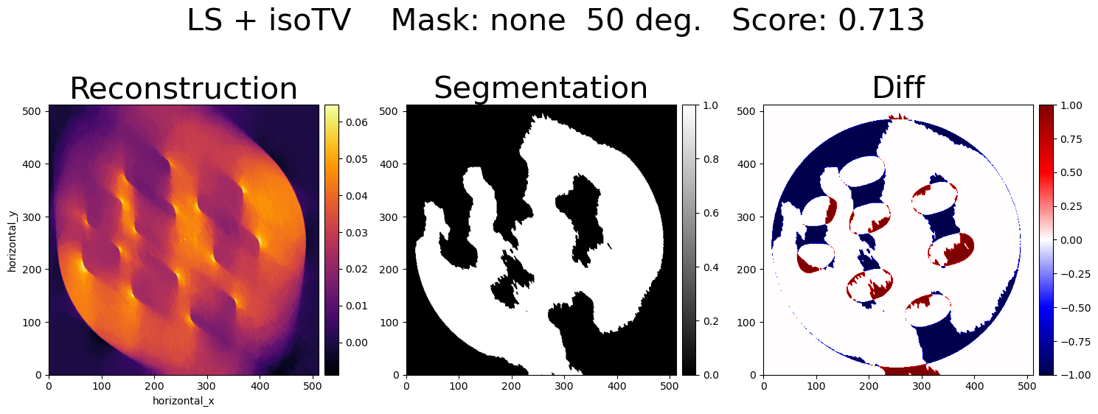
Prior knowledge: homogeneous material with sharp edges
56

Slide 57


Prior knowledge: approximately disk shaped
I.D. Coope Circle fitting by linear and nonlinear least squares in 2D
https://link.springer.com/article/10.1007/BF00939613

Slide 58


Disk shape with known attenuation as constraints
58

Slide 59



Anisotropic TV
Blurred edges along central projection direction
Rotate to align with coordinate axis
Apply single-directional TV to encourage edges in blurred direction
Remember to check convergence!
Rotate back

Slide 60


LS + ITV + mask + ATV
Jørgensen, J.S., Papoutsellis, E., Murgatroyd, L., Fardell, G. and Pasca, E., 2023. A directional regularization method for the limited-angle Helsinki Tomography Challenge using the Core Imaging Library (CIL). Applied Mathematics for Modern Challenges, 1(2), pp.143-169.
60

Slide 61


LS + ITV + mask + ATV (converged!)
Jørgensen, J.S., Papoutsellis, E., Murgatroyd, L., Fardell, G. and Pasca, E., 2023. A directional regularization method for the limited-angle Helsinki Tomography Challenge using the Core Imaging Library (CIL). Applied Mathematics for Modern Challenges, 1(2), pp.143-169.
61

Slide 62




Primal Dual Hybrid Gradient (PDHG) method in CIL
CIL offers a range of optimization algorithms, incl GD, FISTA, ADMM and PDHG:
Rewrite our optimization problem for PDHG:

Slide 63
Solving with CIL – "near-math" syntax
F = BlockFunction( a1*L2NormSquared(data),
a2*MixedL21Norm(),
a3*L1Norm() )
K = BlockOperator( ProjectionOperator(ig, ag),
GradientOperator(ig),
FiniteDifferenceOperator(ig,'horizontal_x') )
G = IndicatorBoxPixelwise( lower=0.0,
upper=v*m )
algo = PDHG( initial=ig.allocate(0.0),
f=F,
g=G,
operator=K,
max_iteration=2000 )
algo.run()

Slide 64

Results on even fewer angles…

Slide 65
Ideas to explore if more time
Improved segmentation – area we spent least time
Enforce acrylic value in outermost circular band
Combine with L1-norm sparsity regulariser to force zero values

Slide 66
Time to explore
Go to:
CIL-Demos/demos/4_Deep_Dives/03_htc_2022.ipynb
The objective of this notebook is to see examples of:
incorporating prior knowledge of a problem in a variational regularisation framework
utilising the flexibility and near-math syntax of the CIL optimisation toolkit to prototype different reconstruction objectives
the CIL Block Framework and PDHG optimisation algorithm

Slide 67
Questions?

Slide 68
Break

Slide 69
Training Program
Intro to variational regularisation and optimisation – 1:00-2:30 – Margaret
Intro lecture
Cloud set-up
Demo: 2_Iterative/Optimisation_gd_fista.ipynb
Optional notebook: 4_Deep_Dives/01_callbacks.ipynb
Optional notebook: 4_Deep_Dives/04_preconditioner_stepsize.ipynb
Break
Block Framework - 2:45-3:45 – Jakob
Demo: 2_Iterative/02_tikhonov_block_framework.ipynb
Block framework example lecture
Notebook: 4_Deep_Dives/03_htc_2022.ipynb
Break
Time to explore and discuss – 4:00-4:50 – Jakob
  Notebook: 3_Multichannel/03_Hyperspectral_reconstruction.ipynb
  Notebook: 2_Iterative/05_Laminography_with_TV.ipynb
  Notebook: 1_Introduction/excercises/03_where_is_my_reader.ipynb
  Notebook: 4_Deep_Dives/04_phase_retrieval.ipynb
Conclusions 4:50-5

Slide 70





Time to explore
Notebook: 3_Multichannel/03_Hyperspectral_reconstruction.ipynb
Identify the key differences in building Image/Acquisition Geometries and Operators for hyperspectral datasets
Build your own reconstructions using FDK, CGLS and PDHG
Determine optimum regularisation parameters based on reconstruction method
Evaluate the effectiveness of each reconstruction routine using spatial and energy profiles.
Notebook: 2_Iterative/05_Laminography_with_TV.ipynb
Construct an advanced AcquisitionGeometry by-hand to describe the tilted and offset data
Use this geometry to read in a tiff stack and create an AcquisitionData object
Create a custom ImageGeometry around the flat sample
Reconstruct the data with LS and TV
Notebook: 1_Introduction/excercises/03_where_is_my_reader.ipynb
Load and investigate a dataset stored as a tiff using `TIFFStackReader`
Create the CIL geometry using `AcquisitionGeometry.Create_Cone2D`
Combine the data and geometry to form an `AcquisitionData`
Find the Centre of rotation to complete the data geometry description
Notebook: 4_Deep_Dives/04_phase_retrieval.ipynb
Intro to phase contrast imaging, propagation based phase contrast and phase retrieval
Demonstration of the CIL Paganin Processor and Generalised Paganin method in CIL
Demonstration of the effect of propagation distance on phase retrieval methods in CIL

Slide 71
CIL User Showcase
001 – Multibang regularisation
002 – Deblurring with CIL
003 – 1D integral inverse problem
004 – Dynamic CT example
005 – Dynamic MR example (with SIRF)
006 – CT simulation with gVXR
007 – Hyperspectral regularisation
008 - Poisson noise models for the data discrepancy term
009 – Offset CT reconstruction of an apple
010 – Bruker Skyscan reader and reconstruction
011 – Phase contrast Exciscope data
012 – Wavelet sparsity control regularisation
Two more currently in review!
https://github.com/TomographicImaging/CIL-User-Showcase

Slide 72
Questions?

Slide 73
Training Program
Intro to variational regularisation and optimisation – 1:00-2:30 – Margaret
Intro lecture
Cloud set-up
Demo: 2_Iterative/Optimisation_gd_fista.ipynb
Optional notebook: 4_Deep_Dives/01_callbacks.ipynb
Optional notebook: 4_Deep_Dives/04_preconditioner_stepsize.ipynb
Break
Block Framework - 2:45-3:45 – Jakob
Demo: 2_Iterative/02_tikhonov_block_framework.ipynb
Block framework example lecture
Notebook: 4_Deep_Dives/03_htc_2022.ipynb
Break
Time to explore and discuss – 4:00-4:50 – Jakob
  Notebook: 3_Multichannel/03_Hyperspectral_reconstruction.ipynb
  Notebook: 2_Iterative/05_Laminography_with_TV.ipynb
  Notebook: 1_Introduction/excercises/03_where_is_my_reader.ipynb
  Notebook: 4_Deep_Dives/04_phase_retrieval.ipynb
Conclusions 4:50-5

Slide 74
Questions?

Slide 76
Spare slides

Slide 77

CIL example - non-standard scan

Slide 78

CIL example - few-view dynamic CT

Slide 79

Energy-resolved neutron CT

Slide 80

CIL community

Slide 81
Who is CIL for?
CT experimentalists
  Optimised standard algorithms for large data
  Batch processing
  To utilise reconstruction algorithms for poor data quality or to handle novel imaging modalities
Image processing specialists
  to easily implement new reconstruction algorithms
  assess them against existing ones.

Slide 82
CIL Module Structure and Contents
recon
FBP/FDK
Jørgensen et al. 2021: Core Imaging Library - Part I: a versatile Python framework for tomographic imaging, Phil. Trans. R. Soc. A, 379, 20200192: https://doi.org/10.1098/rsta.2020.0192
The cil.plugins module contains wrapper code for other software and third-party libraries that need to be installed separately to be used by CIL.

Slide 83


Documentation
https://tomographicimaging.github.io/CIL

Slide 84
Filtered Back Projection (FBP)
Pros
Cons
Fast as based on FFT and backprojection
Few parameters
Typically works very well
Reconstruction behaviour well understood
Number of projections needed proportional to acquisition panel size
Full angular range required (limited angle problem)
Modest amount of noise tolerated
Fixed scan geometries
Cannot make use of prior knowledge such as non-negativity

Slide 85


Algebraic Iterative Methods regularising by number of iterations
CGLS
Typically 10s of iterations
SIRT
As above and allowing
lower and upper bounds
on pixel values, here
Non-negative and <= 0.9
Typically 100s of iterations
85

Slide 86

CIL Publications
Jørgensen et al.: Core Imaging Library - Part I: a versatile Python framework for tomographic imaging Phil. Trans. R. Soc. A. 379 20200192 (2021) DOI: 10.1098/rsta.2020.0192
Papoutsellis et al.: Core Imaging Library - Part II: multichannel reconstruction for dynamic and spectral tomography Phil. Trans. R. Soc. A.37920200193 (2021) DOI: 10.1098/rsta.2020.0193
Jørgensen et al.: A directional regularization method for the limited-angle Helsinki Tomography Challenge using the Core Imaging Library (CIL), Applied Mathematics for Modern Challenges, Volume 1, Issue 2: 143-169. (2023) 10.3934/ammc.2023011
Ametova et al.: Crystalline phase discriminating neutron tomography using advanced reconstruction methods, J. Phys. D: Appl. Phys. 54 325502 (2021) DOI 10.1088/1361-6463/ac02f9
Warr R. et al.: Enhanced hyperspectral tomography for bioimaging by spatiospectral reconstruction Sci Rep 11, 20818 (2021) DOI: 10.1038/s41598-021-00146-4
Brown R. et al: Motion estimation and correction for simultaneous PET/MR using SIRF and CIL Phil. Trans. R. Soc. A.379 20200208 (2021) DOI:10.1098/rsta.2020.0208

Slide 87
CCPi = CCP in Tomographic Imaging
The Collaborative Computational Projects (CCPs)
UK Network of expertise in key computational research fields
CCP’s foster exchange by organising workshop, training, conferences …
Enable large-scale scientific software development, maintenance and distribution.
Long term funding by EPSRC with a 5 years renewal cycle
CCP’s are supported by the Computational Science Centre for Research Communities (CoSeC).
https://www.ccpi.ac.uk

Slide 88
Conclusion
CIL is a Open Source mostly Python library for all your tomographic needs:
  I/O
  pre-processing
  Reconstruction
  Visualisation
Developer Support, user driven, long term funding
Join the community Discord
https://www.ccpi.ac.uk/CIL
Discord community:
discord.gg/ky7yCqRcYn

Slide 89


Core Imaging Library for CT and other inverse problems
data = ZEISSDataReader(filename).read()
data = TransmissionAbsorptionConverter()(data)
show_geometry(data.geometry)
recon = FDK(data).run()
show2D(recon)
Data readers/writers
Pre-processing tools
Image reconstruction
Near math optimisation syntax
Visualisation
2D, 3D and 4D data
TIGRE and ASTRA backend
ccpi.ac.uk/CIL

Slide 90

What is Total Variation?
Measures variation of an image
Sum of gradient magnitude image
Prior: few homogeneous regions with simple boundaries
Quite successful in tomography, in particular for reduced data

